Slide 1
FACEWORK SKILLS CHALLENGE
MANAGING CONFLICT
Are you a person who can recognise when conflict is brewing? Are you known as someone who can understand other people’s point of view and be a peace-maker? If so, you are person who is good at managing conflict, and you are probably someone who is well respected.
But we can all get better at this skill.
In this Facework challenge we show you why this skill is so important in the workplace, especially because conflicts spring up quickly. We will also show you how you can use this skill in your personal life and in wider society.
Before you start, rate yourself on how good you think you are:
ARE YOU UP FOR THE CHALLENGE TO IMPROVE ?

Slide 2
Work can be a place where conflicts quickly come to the surface. Sometimes these conflicts can be external, for example, conflict with customers, supplier or a competitor. But when there is internal conflict in a team this conflict can lead to a breakdown in trust and communication and can have a disastrous impact on individuals and the company.
Conflict in itself can be positive, (see below), but when it is ignored the damage to staff and even the company ‘brand’ can be very serious. So employers need staff who can become good at spotting conflict, communicating quickly and honestly and, most importantly, finding solutions to conflicts.
Why is unresolved conflict in the workplace so serious?
DECREASED PRODUCTIVITY
When conflict is unresolved, workplace performance and productivity suffers. According to the Centre for Conflict Resolution, more than 65% of performance problems at work stem from strained workplace relationships. An overall unhealthy work environment can create divided teams and even teams within teams.
MENTAL HEALTH OF EMPLOYEES
When conflicts are not resolved, staff can lose their morale and become stressed. Distrust arises when people suppress feelings or are afraid to speak out. When staff are mis-treated or abused (including bullying) it can be very serious and possibly criminal.
ABSENTEEISM AND HIGH STAFF TURNOVER.
Unresolved conflict at work can lead to high levels of absenteeism or staff quitting. If there are certain sectors of a workforce are treated unfairly (for example women, or those from different ethnicities or areas), it can lead to staff feeling victimized.
BUT NOT ALL CONFLICTS ARE BAD
It is important to recognise that the absence of conflict may not be a good thing. For example:
When there is a culture of fear, some staff may be scared of raising concerns because they may be marginalised or blamed. Think of the consequences of ignoring a conflict about workers’ safety!
When there is a culture of laziness staff may not bother to disagree for an easy life.
When there is a lack of diversity or divergent views, it can lead to lack of creativity or innovation. Staff may leave for a competitor who embraces challenge and new ways of working.

Slide 3
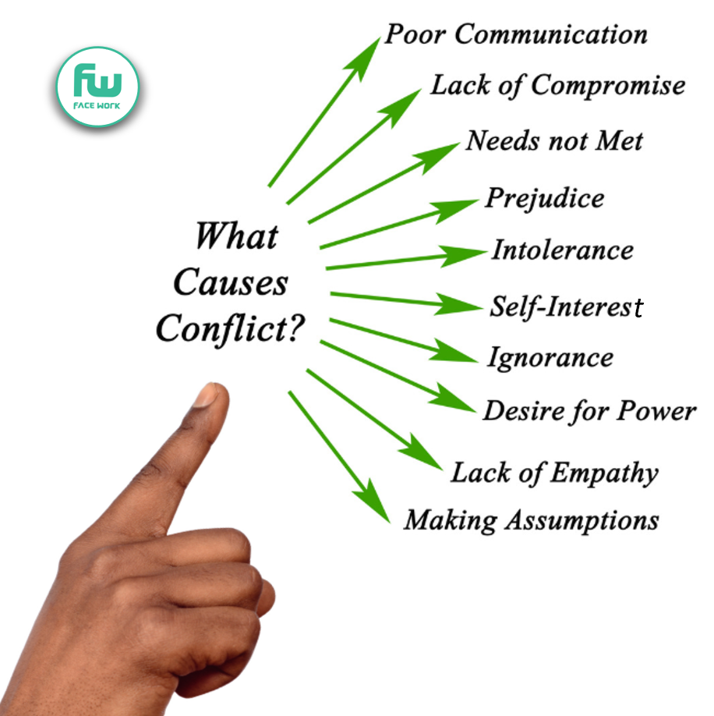
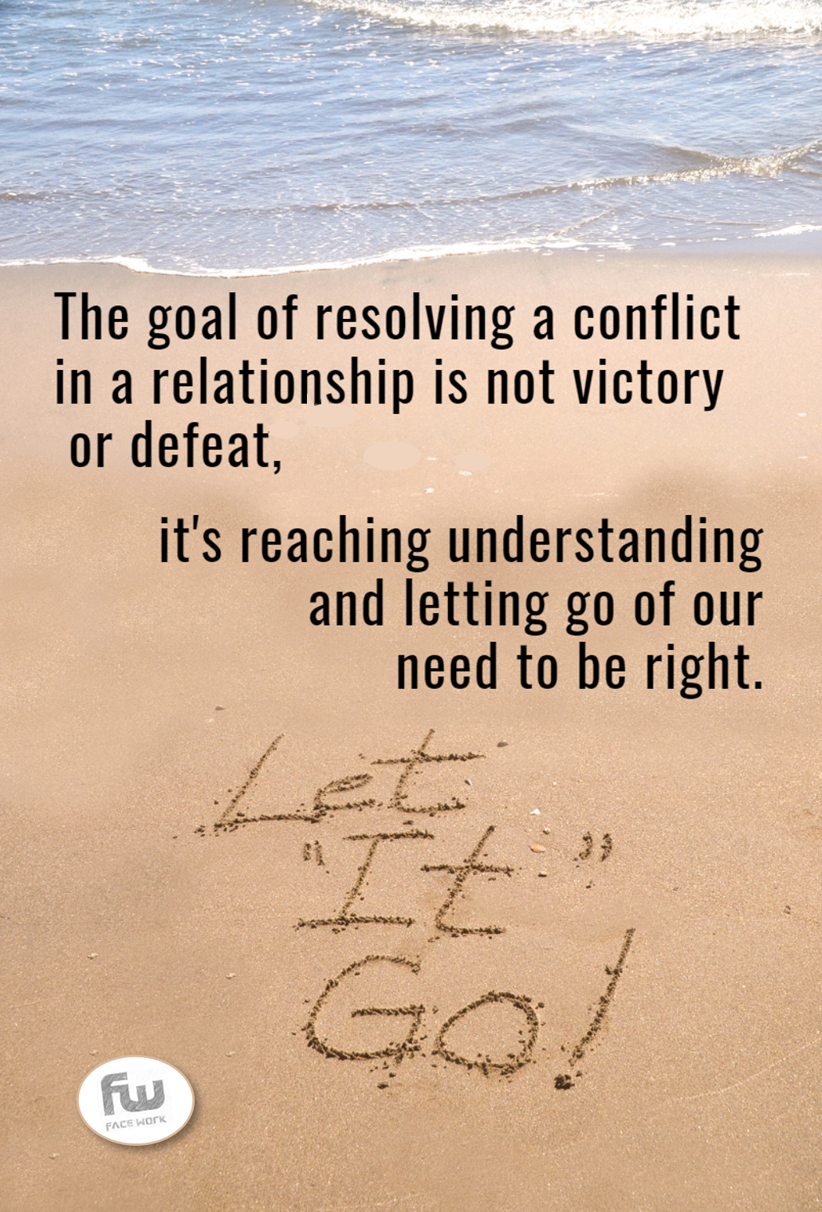
If you can get good at managing conflict in a work place, you
can apply this skill to lots of areas in your life.
Think of a current conflict you have in your home or personal life.
From the 10 causes of conflict
(see left), which ones do you think
are contributing to this conflict?
Be honest with yourself and ask:
which ones apply mostly to me? Eg:
Are your needs being met?
Do you harbour prejudice?
Are you making assumptions?
Are you communicating how you feel ?
Then assess honestly, are you accepting responsibility for these?
Next, identify the ones which you think are driving the conflict from the other party. Could you do this exercise together?
Some might say conflicts in the family are more difficult than ones in your place of work. This is because as you move from childhood to young adulthood your needs change.
How we communicate is key to resolving conflict or increasing conflict. Find creative ways to communicate and remember not everything is communicated through words!

Slide 4
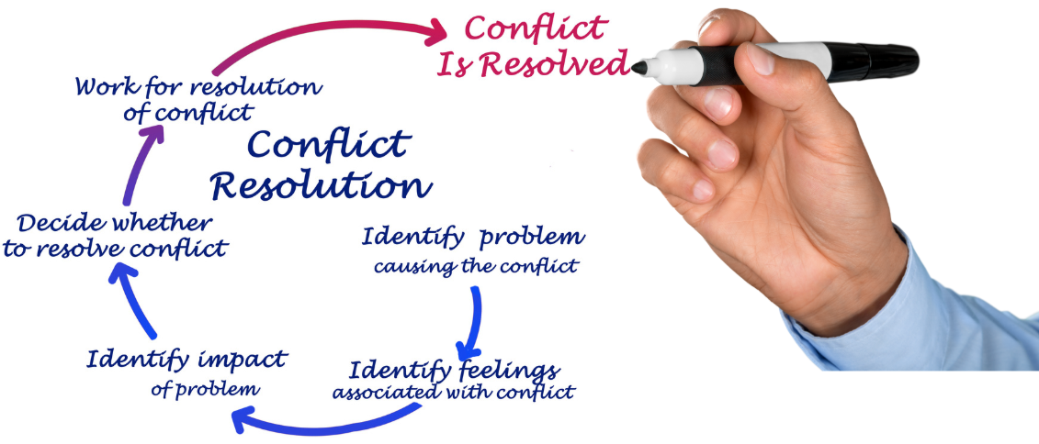
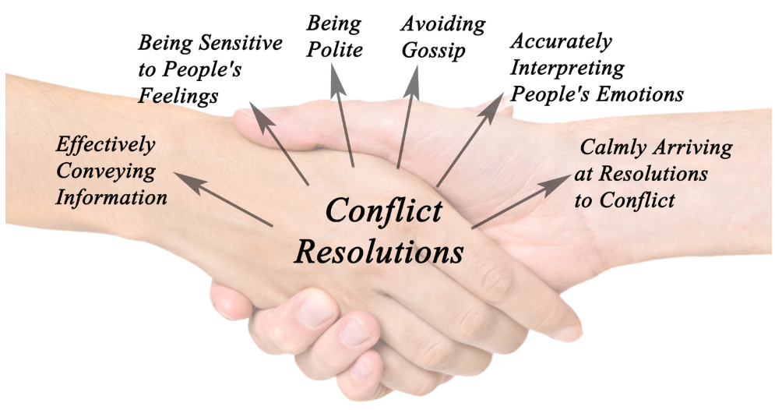
Work places can be a source of pressure and stress. Sometimes different conflicts spring-up unexpectantly. For example generational conflicts are common with young workers having different attitudes to older workers. There can also be conflicts when new ways of working are introduced, for example using ICT and or social media marketing. People can feel threatened by change especially if they aren’t confident in using new platforms. and procedures at work. Then there are external conflicts like the impact the Covid-19 pandemic is having. Little wonder these disruptions can bring conflict and uncertainty.
The diagram above shows the different steps companies use to find a way through conflicts.
Identifying the problem involves listening and observing carefully.
Next, identifying the feelings associated with the conflict is important as often these feelings are based on fear, or because people don’t feel they are being heard. Giving people a safe space to air their views is crucial.
Starting to investigate what impact the conflict is having is important because you will need clear objective evidence of the impact the conflict is having if you are to bring people together.
Sometimes just listening to all sides in a conflict and working to identify the impact the conflict is having on people and the business is enough to get people to work on resolving the conflict. If this doesn’t work you will need to be more structured in resolving the conflict.
What’s crucial (and what is not shown on the diagram above) is making sure that you monitor the impact of the conflict resolution to see if the conflict has been resolved
When you are helping to manage conflict these tips below are important.
There are a wide range of careers open for people who are good at managing and solving conflicts.
Can you think of at least 3?

Slide 5
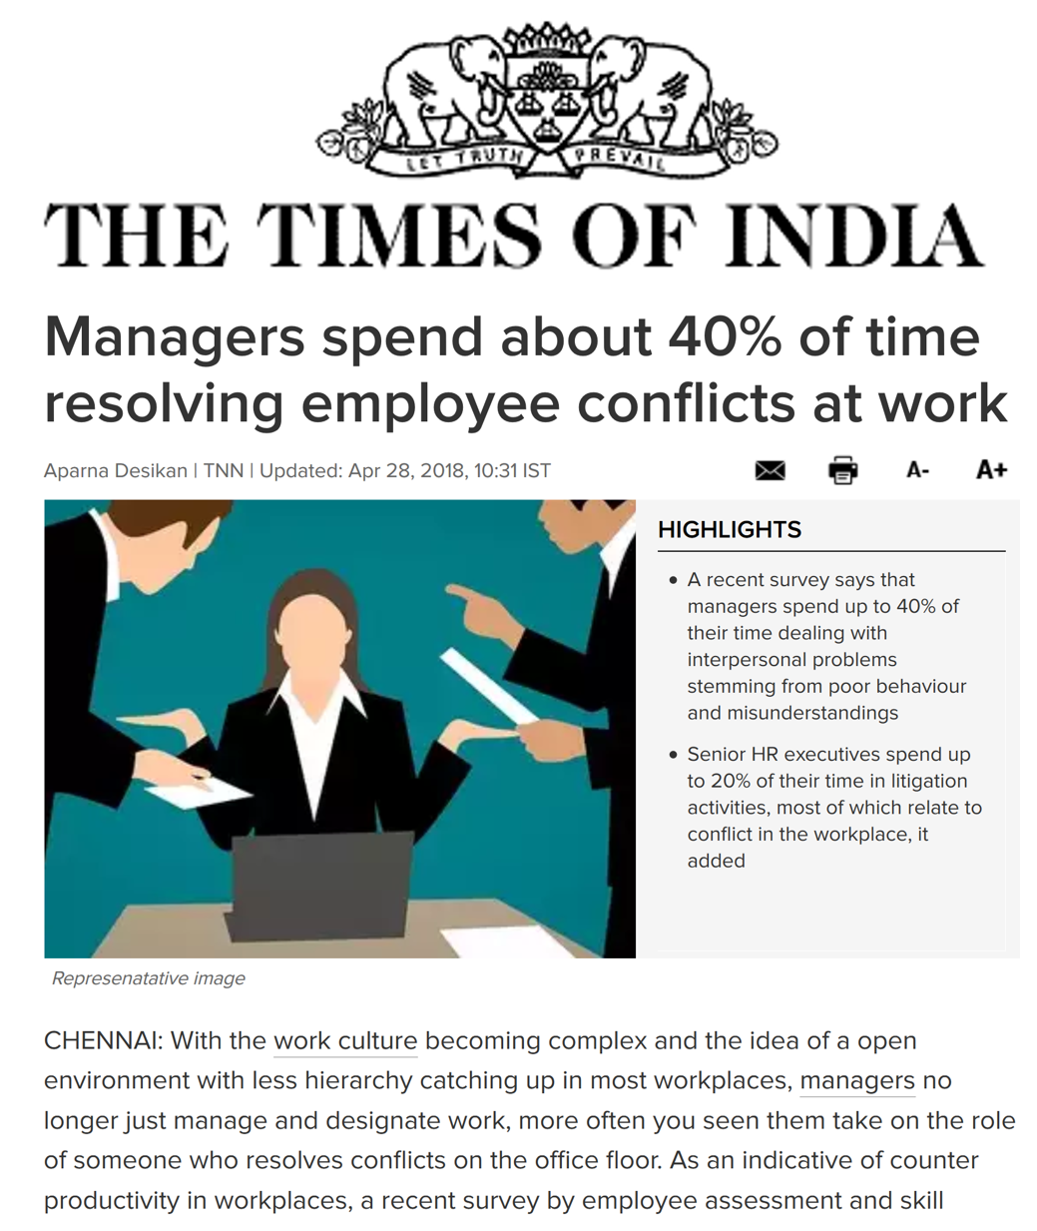
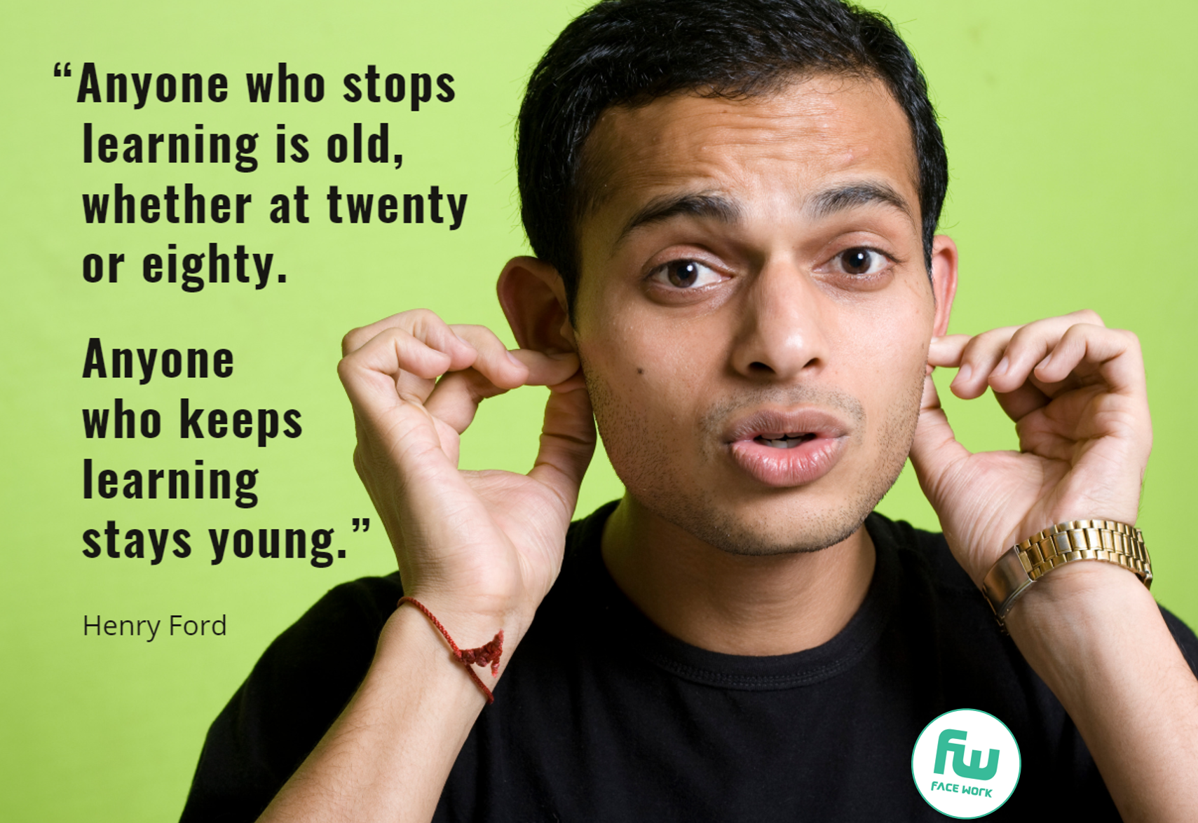
The Facework Challenge we have set to help you improve your skills in managing conflict involve undertaking three specific tasks:
CHALLENGE 1 UNDERTAKE FURTHER RESEARCH
There are lots of online articles about managing conflict, including this one from the Croydon Times. Find out three key facts about this subject and if you have a social media account why not tweet or share a summary of what you have learnt to your network. Alternatively complete a diary entry on what you have learnt.
The Croydon Times
CHALLENGE 2 SHARE WHAT YOU’VE LEARNT WITH A FRIEND
This is a very valuable way to reinforce what you have learnt and gain confidence in your ability to grasp the concepts of managing conflict. Maybe you could start by asking your friend whether they are facing a conflict in their work or at home. How could you use the tips on pages 3 & 4 with them?
CHALLENGE 3 RATE YOURSELF AGAIN ON YOUR SKILLS LEVEL.
Return to the score card you completed on page 1, how would you now rate your skills in managing conflict? (See score card below).
If you have improved, how have you done this and how are you now going to put this theory into practice?
Now rate yourself again on how good you think you are:
I’ve learnt ………………………………
………..................................................………………………………………………………………………………………………………....... about managing conflict.

Slide 6
