Slide 1
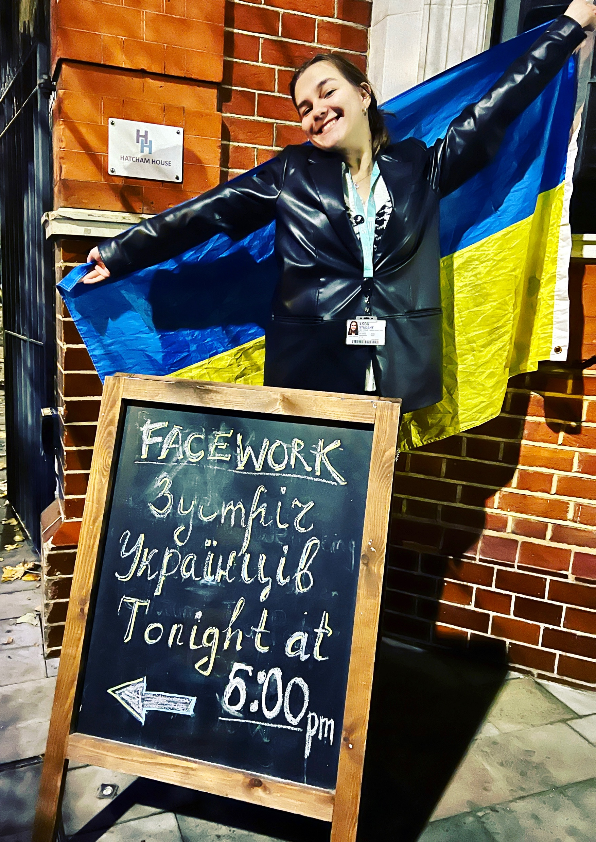
s FACEWORK
UKRAINE

Slide 2
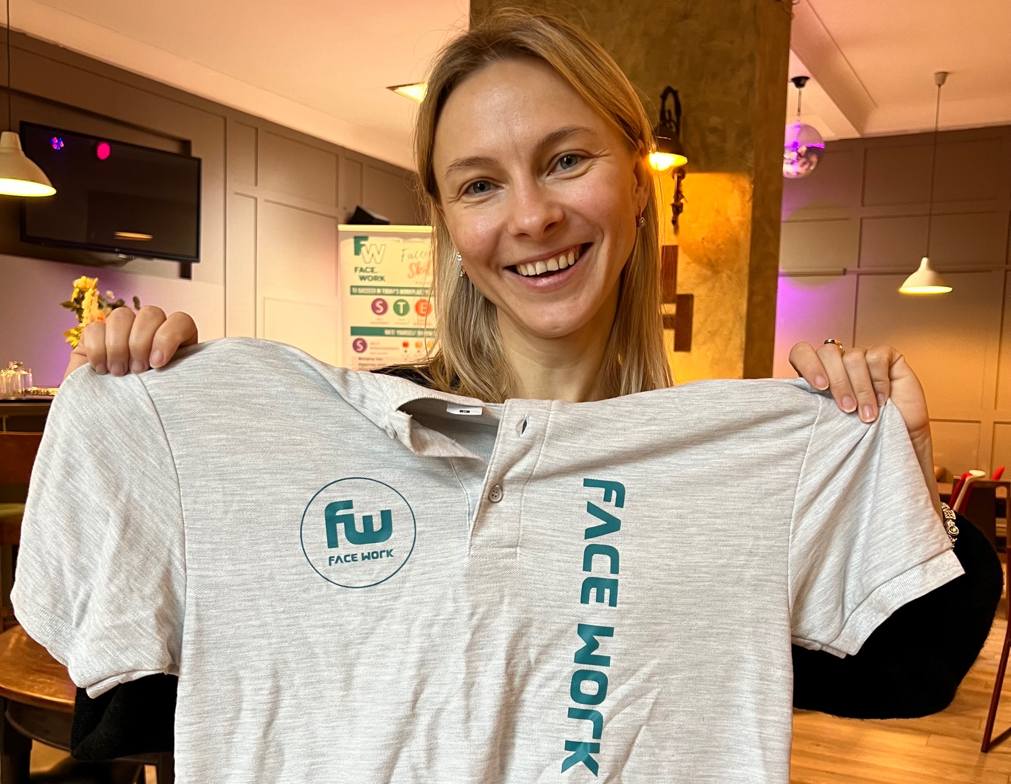
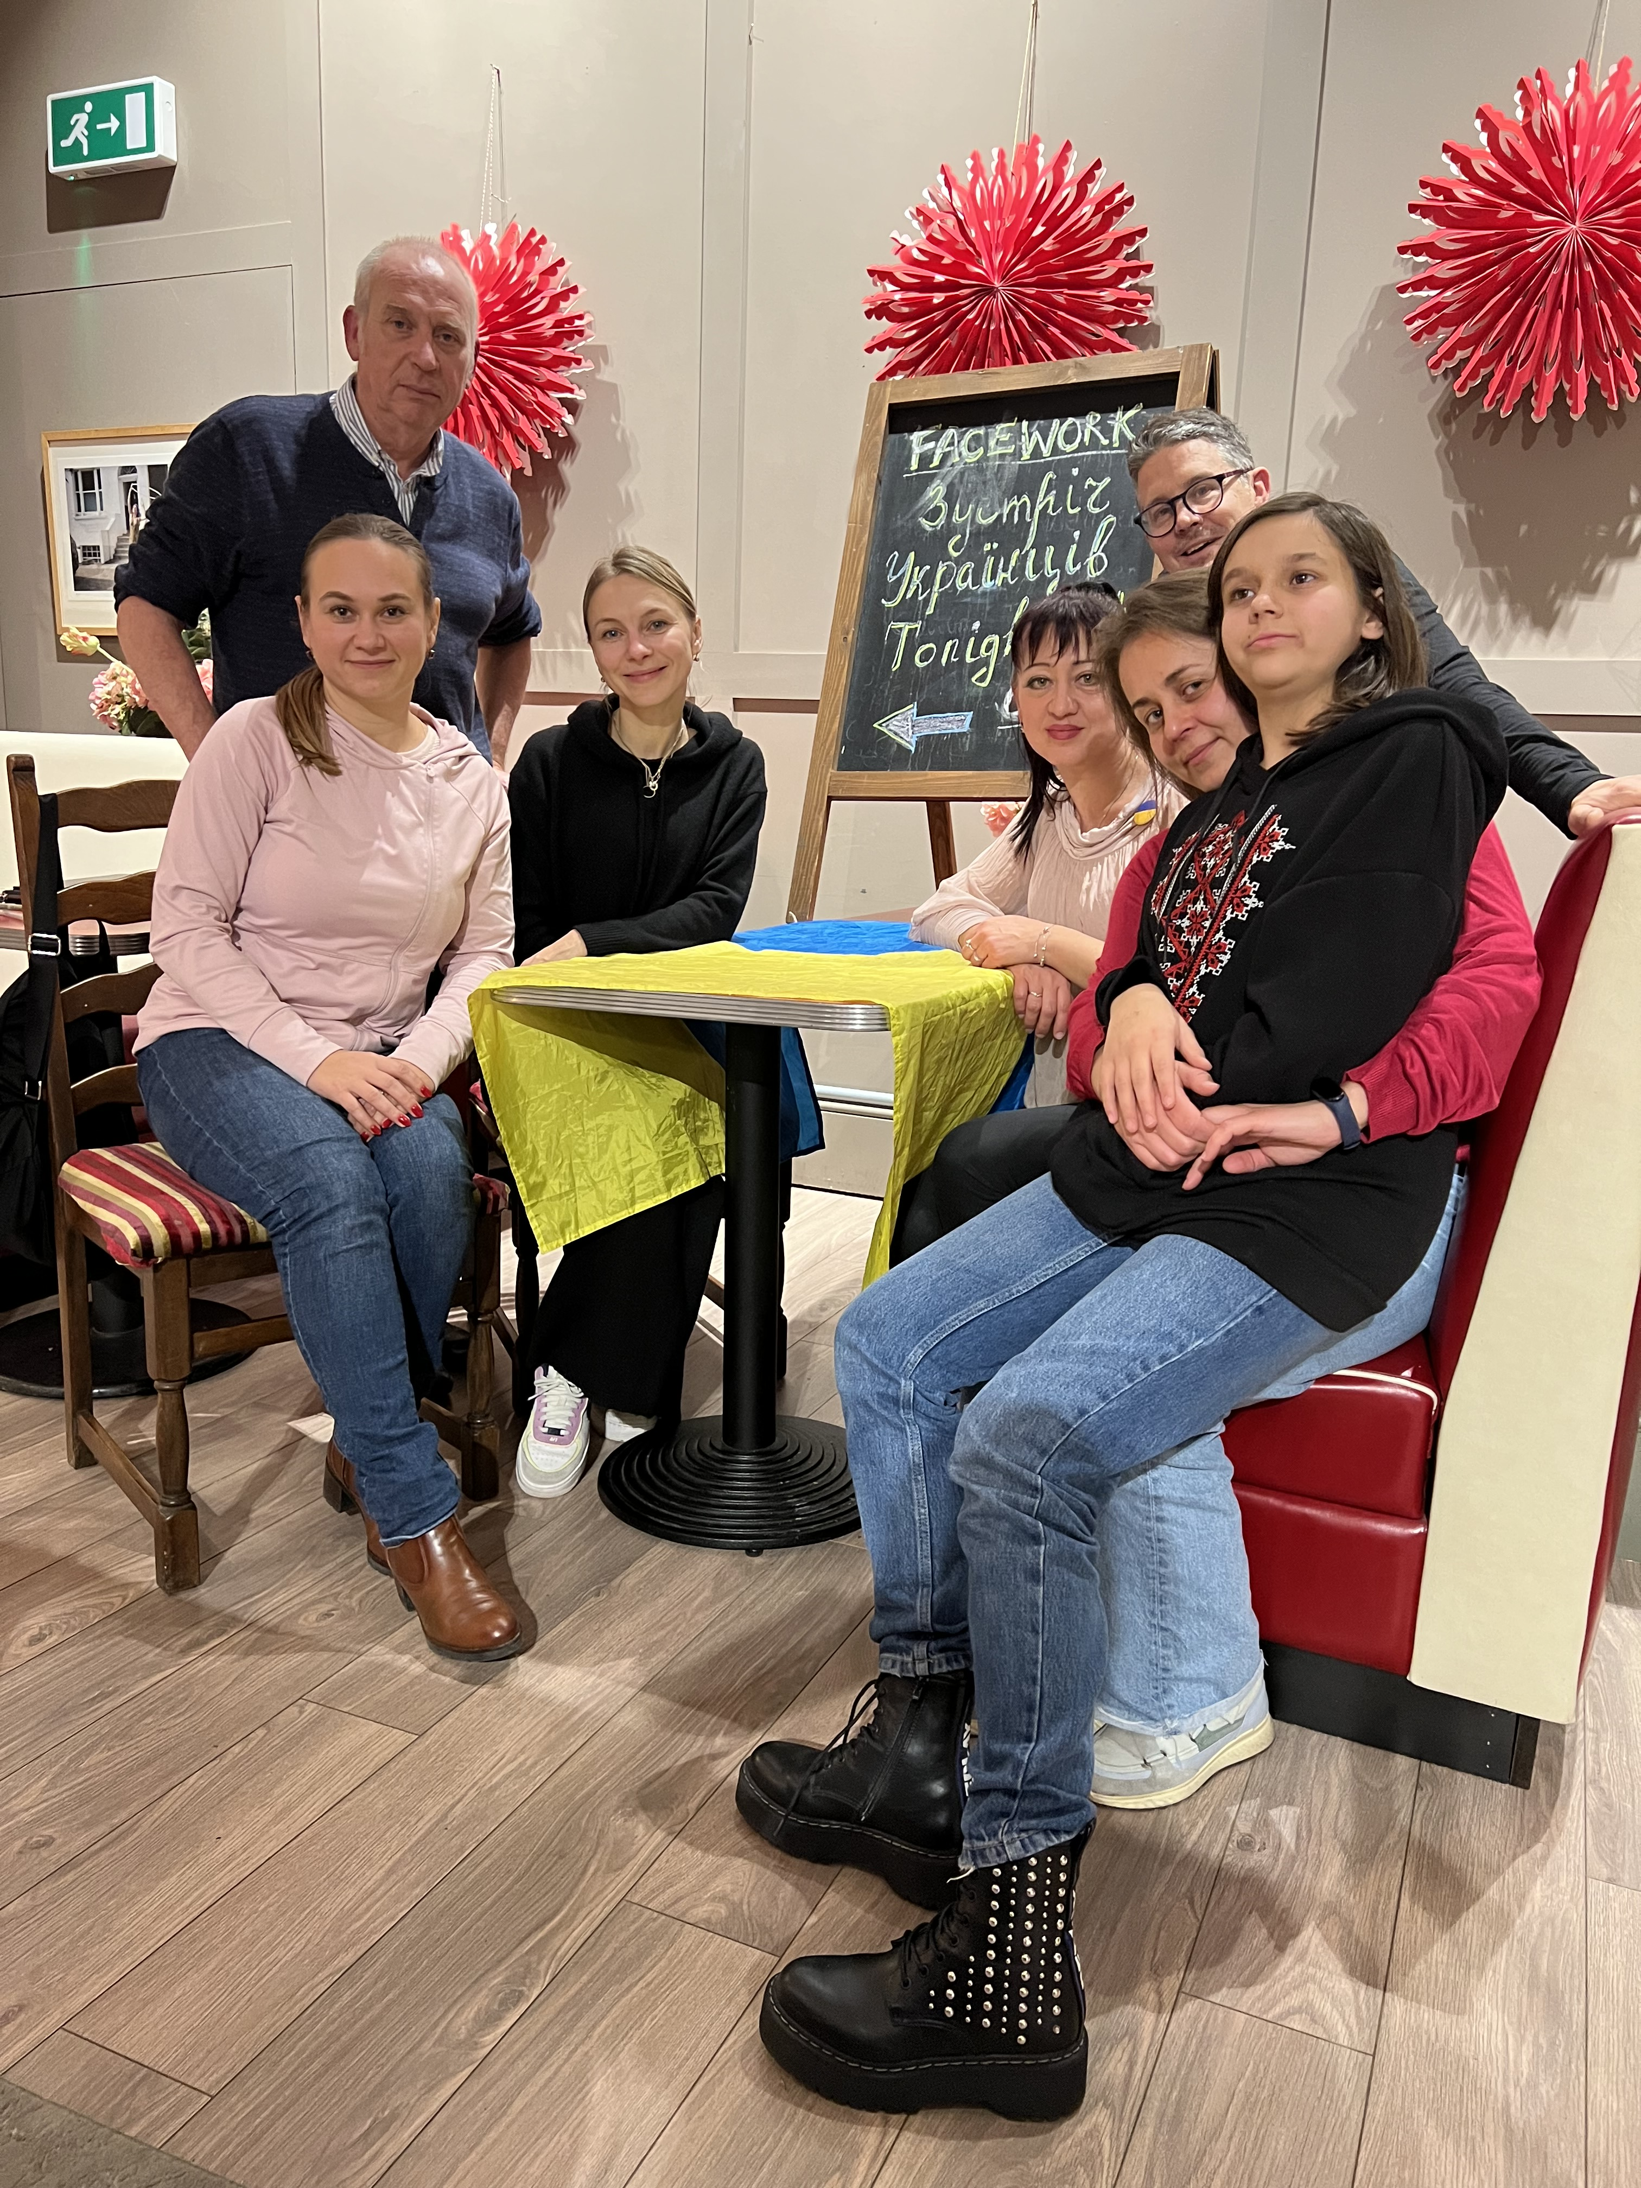
s WELCOME
Introductions
Timings
Health & Safety
Filming (permission)
Translation help
Mariana Vyniarska
Co-ordinating team

Slide 3
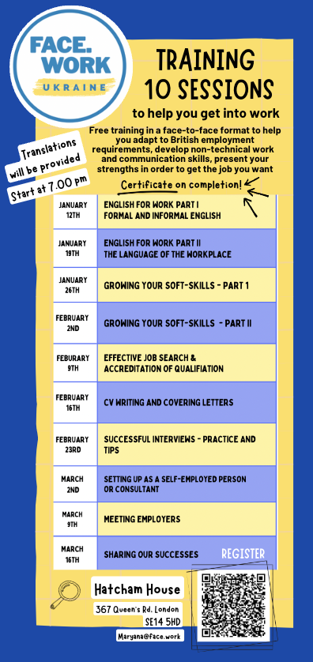
For us, by us, to provide skills training and a network which helps us gain confidence and find good quality work or further training whilst we are in the UK and when we return to Ukraine.

Slide 4
?
What about you ?
How would you introduce yourself formally ?
What is one thing would you say about yourself that the person you are meeting would remember you by?

Slide 5
ANY QUESTIONS
SO FAR ?
THERE IS NO SUCH THING AS A SILLY QUESTION !

Slide 6
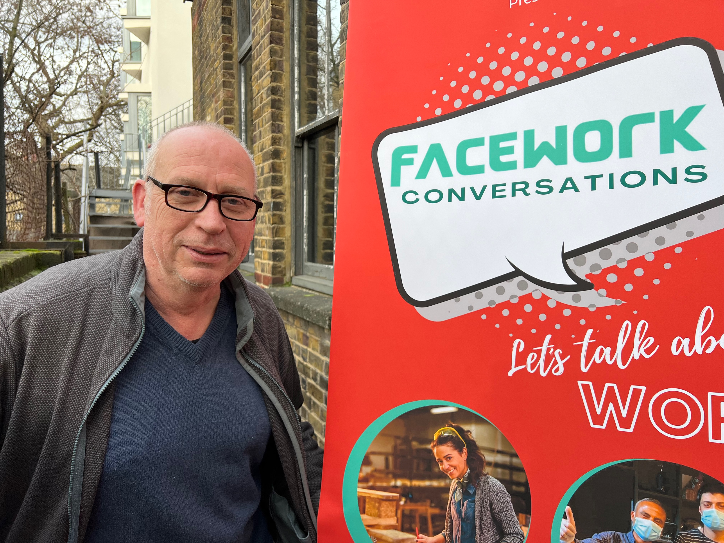
TODAY’S SESSION
David Powell
A qualified English language teacher, former Cambridge team leader for English main suite exams and IELTS in Ukraine. A proven ability to teach, motivate and direct students by encouraging a positive and energetic environment.

Slide 7
LEARNING BY DOING !
ICE BREAKER

Slide 8
1️⃣
FORMAL AND INFORMAL LANGUAGE
2️⃣
USING UkrENGLISH
3️⃣
Messed Up / Mixed Up
4️⃣
What should you never say !
All with practical exercises, fun and take away tips to help build your confidence!
What you learn with pleasure you never forget !

Slide 9
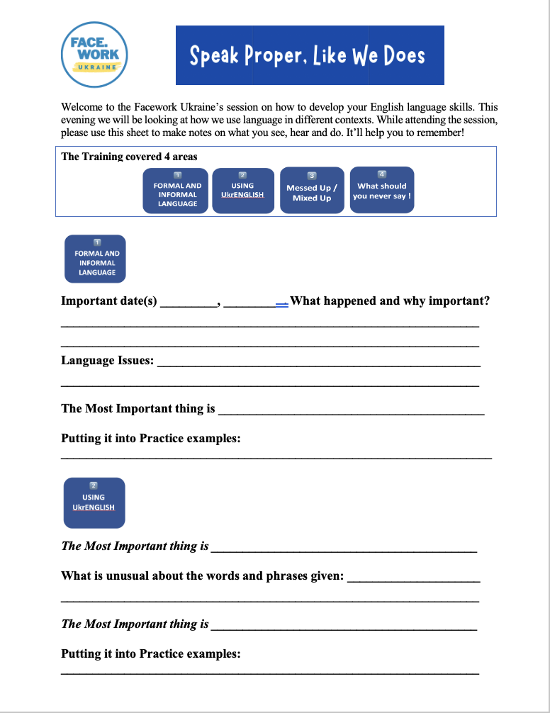
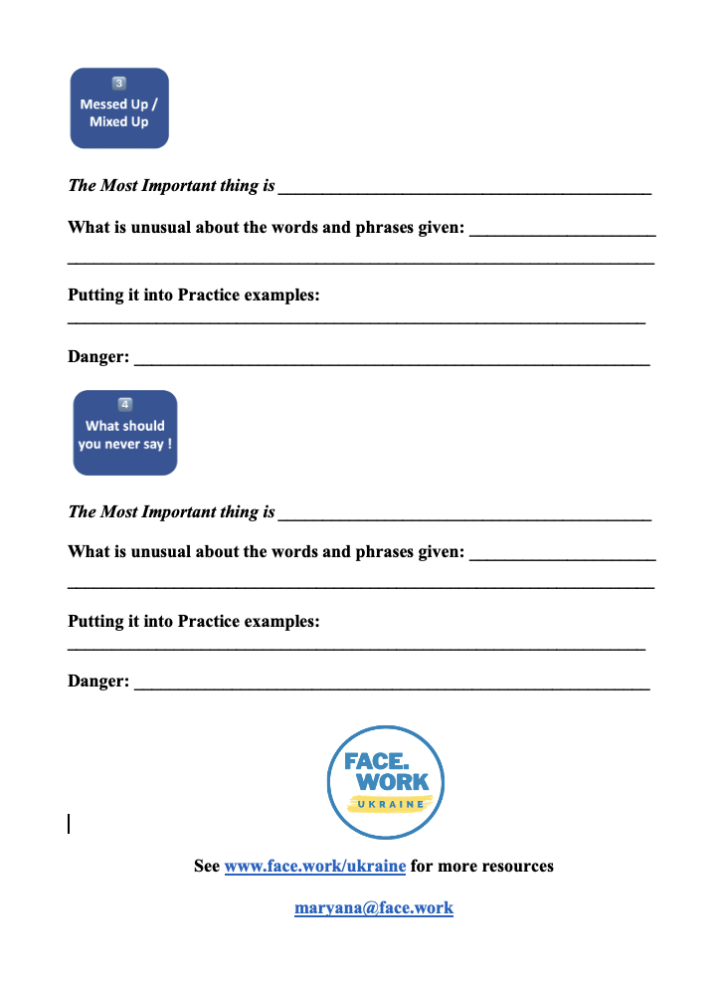
Hand out to work on and take away with you
See www.face.work/ukraine for more resources

Slide 10
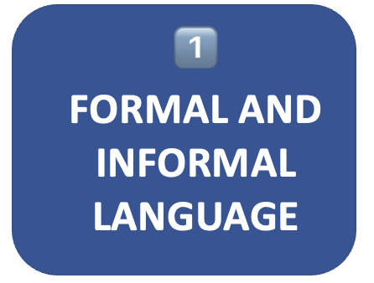
What words and expressions are (usually) formal / Informal?

Slide 11
Why?

Slide 12
Test
Let’s see what you remember.
Formal: arrive Informal: ________
Formal: ________ Informal: fill out

Slide 13
Sorry

Slide 14
Obtain

Slide 15
Beverage

Slide 16
Speak Appropriately
So

Slide 17
Remember who we are speaking to
Keep

Slide 18
What do we want them to do
Ta

Slide 19
ANY QUESTIONS
SO FAR ?
THERE IS NO SUCH THING AS A SILLY QUESTION !

Slide 20
David – do you have some content for this section ?

Slide 21
ANY QUESTIONS
SO FAR ?
THERE IS NO SUCH THING AS A SILLY QUESTION !

Slide 22
David – do you have some content for this section ?

Slide 23
ANY QUESTIONS
SO FAR ?
THERE IS NO SUCH THING AS A SILLY QUESTION !

Slide 24
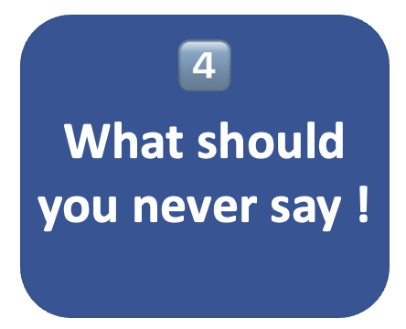
David – do you have some content for this section ?

Slide 25
ANY QUESTIONS
SO FAR ?
THERE IS NO SUCH THING AS A SILLY QUESTION !

Slide 26
CERTIFICATE OF
ATTENDANCE
This is to certify that
-----------------------------------------------------------
has attended an intensive Facework training course in soft-skill development for the workplace in autumn 2023.
This candidate also contributed to helping the Facework team develop new employability training content for the Facework Ukrainian programme.
.............................................
Stephen Carrick-Davies
Facework Founder
Facework UK
.......................................
Mariana Vyniarska
Facework Ukraine Manager

Slide 27
NEXT WEEK’S SESSION

