Slide 1
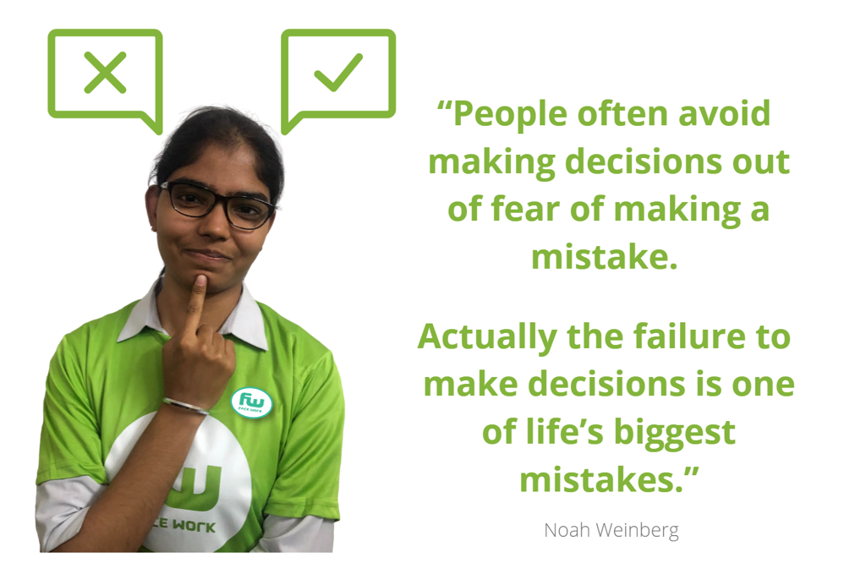
FACEWORK SKILLS CHALLENGE
MAKING DECISIONS
We make decisions every single day. Some decisions are simple, others are difficult. This may be because sometimes we don’t have all the facts at our disposal. Other times it’s because we lack the confidence to make the decision on our own. Whatever the reason, when you start work you have to become good at making decisions. This involves considering all the facts, comparing different options, thinking on our feet, taking risks, and finally committing to a decisive course of action. These are all skills we can learn, even if it takes a lifetime to master.
The good news is that this Facework challenge will help you improve this important skill. Who knows, taking the time to become better at making decisions could be the best decision you make!
ARE YOU UP FOR THE CHALLENGE TO IMPROVE ?

Slide 2
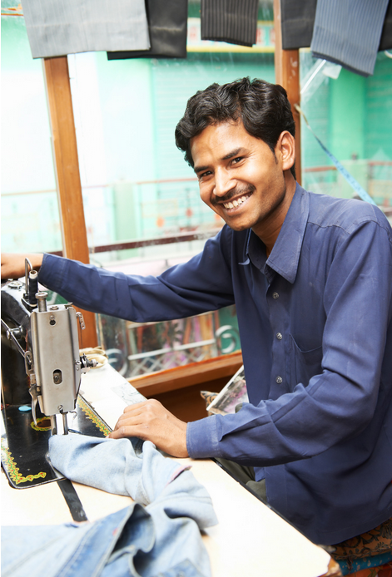
Everyday those who run businesses have to make hundreds of decisions. Sometimes these are very simple ones, other times they are more complex. Employers need staff who understand that decisions need to be made, who will contribute to the decision making process and who are supportive once decisions are made. Indeed as you grow in your career you too will have to make decisions. So how do we improve?
Here are 5 tips:
DISCOVER YOUR VOICE. Sometimes we struggle to make decisions because we may not have strong opinions, or if we do we don’t feel anyone will listen to us. When you begin work you can develop confidence and discover your voice by expressing your views. Building confidence can take time, but these questions will help you on your journey to discover your passion and your voice. What angers you? What gives you hope? Who inspires you? If you had one day left, how would you spend it?
2) DECISIONS ARE MADE ON DATA. When making a decision gather all the facts and consider the situation in detail. It’s important that you can support your decision with facts – especially if the decision is divisive. If you can demonstrate how you have made a decision based on facts it will give you authority and confidence. “In making this decision I have reviewed the facts and the evidence all points to…” A warning; we live in an age of false news and information so check your sources.
3) EXPLORE YOUR OPTIONS. Sometimes people make decisions on an emotional, or ‘gut’ level. Before you rush into making a decision, ask yourself what are the other choices? It can take time but it’s good to ask other people and explore other options. Could you say “I’m having to make a decision between two options. I think I know what is the best one, but can I ask you to play devil’s advocate and critique my decision and think about the other options?”
4) COMMUNICATE, COMMUNICATE, COMMUNICATE! Making decisions can be stressful. When we become stressed we can retreat and fail to communicate, maybe the decision seems too difficult to discuss! However, when people find out about the decision after it has been made, it can lead to tension especially if a decision affects a team. Consult and take people with you when you have to make a decision, What about, “ I am having to make a big decision, but I want all those affected by the decision to have their say.”
5) REVIEW YOUR DECISION AND LEARN FROM MISTAKES. We learn from mistakes but as someone once said, “More people would learn from their mistakes if they weren’t so busy denying them!” So it’s vital that as you grow in your career that you can recognise, accept and admit when you have made mistakes. “I realised I made a mistake in my decision, but I can now see…..”
Which of the above 5 tips applies most to you ? ………………………………………………...
What will you do to improve in this area? ……………………………………………………………

Slide 3
Getting better at making decisions can help you in your personal life.
Think of a time when you have had to make a big personal decision and complete this exercise in the table below.
What was the personal decision you had to make? | ………………………………………………………………
What helped you make the decision? | ……………………………………………………………….
Was it the right decision? Why ? | ……………………………………………………………....
What did you learn from having to make this decision? | ………………………………………………………………..
What would you do differently if you had to make the same decision again today? | ………………………………………………………………..
One of the most powerful ways of getting good at making a decision is in imagining you have made the decision. How do you feel ?
Now imagine how you would feel if you avoided making this decision. Remember making no decision is a decision.

Slide 4
There are lots of articles and resources online which can help you master this skill. Here are 6 activities which can help you master the skill of making decisions.
TRY NOT TO WORRY THAT YOU WILL MAKE THE WRONG DECISION
You wont know whether you have made the wrong decision until you have made it. Who knows, you may have made the right one. Worrying is the thief of progress. Yes be cautious, but don’t procrastinate and don’t let fear be your enemy. Remember if you don’t make a decision, that is a decision.
RECOGNISE WHAT YOUR DEFAULT POSITION IS.
As you develop your career you will begin to notice what your default position is. We all have one. Some people call it their “comfort zone”. Think about which way you usually decide things? Do you play safe, or take a risk, do you try to please other people, or say what you really want? Once you have recognised that your natural default, make sure you account for it when you make decisions, it’s not to say that it is wrong, but it may be unduly influencing you.
TALK TO GOOD DECISIONS MAKERS
Do you have a family friend, a previous teacher, or someone you have worked for in the past who you know is a good decision maker? Why not ask them;
What tips do you use to help you make decisions? Have you ever made a bad decision? What advice would give me as I try to get more confident in making decisions?
LEARN TO TRUST YOUR INSTINCT
As you grow in confidence and experience you can start to recognise when you have made a good decision. Think about what it was that helped you make that decision. Sometimes it is your own instinct or insight. Some people can ‘read’ other people well, can identify a trend or a new opportunity. Learn to trust your instinct but also remain humble and open to being wrong. That’s a powerful combination for being a good leader.
STUDY THE PROS AND CONS BEFORE YOU MAKE A DECISION
When trying to make a decision it’s helpful to list the things which are good and which are bad about the options. It’s also important to think about the ‘opportunity cost’ of making one decision over another. An opportunity cost is what you lose by making a decision in one way.
SHARE YOUR ADVICE ABOUT MAKING DECISIONS WITH OTHERS
When you become good at making decisions there are lots of people who will benefit from your insight, experience and skills. Indeed there are lots of jobs which require helping people make decisions. For example, counsellors, financial planners, career coaches and teachers. When you get good at making decisions, a whole world can open up to you and helping other people with decisions can give you enormous job satisfaction.

Slide 5
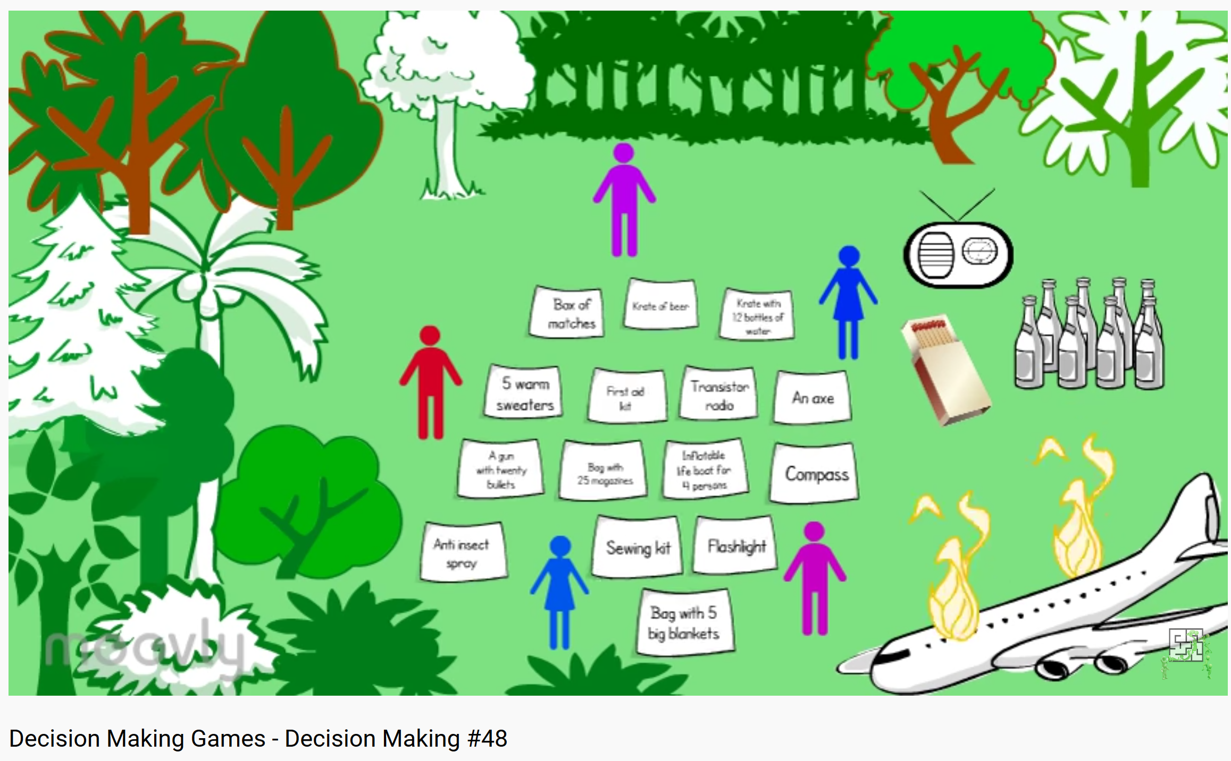
The Facework Challenge for this skill is to help someone make a decision.
Wladyslaw has been invited to attend an interview for a job in a borough 2 hours away. He has enough money to get there by tube and train, but not by cab. The interview takes place at peak travel times and he is concerned that if he goes by rail he may be late, may arrive hot and sweaty and be exhausted.
He also faces the challenge that he has to look after his little sister on the day of the interview and needs to get a relative to look after her for the full day. He has a relative who says she can do it, but needs to be paid for travel to his home.
Wlad also has to tell his current employer that he needs the day off so he can travel for the interview. He isn’t sure whether to tell his current employer about the new job interview, or to tell him that he has to look after his sister.
You have to help Rohan make a decision. Would you advise him to:
a) Take the train there and back so he can save more of his money and thereby pay his relative. However he risk being late for the interview?
b) Borrow some money to take the cab there, and the train back, and pay his relative some of her travel costs so she can look after his sister. (Promising to pay the rest later).
c) Ask his employer if he can have a wage advance so he can afford everything, and tell his current boss he is needing the funds to travel to an interview?
Which option would you advise Rohan to take?
Each of the decisions has a potential positive and negative consequence.
Can you think of other options? If it was you what decision would you make?
How this advice might help your friend.
Think that was challenging, try this online one!
www.youtube.com/watch?v=RlYxBdNxi-A
There are lots of other online videos which help you think about decision making skills. For example:
www.youtube.com/watch?v=pPIhAm_WGbQ
www.youtube.com/watch?v=XT0Awg-Fpxw

Slide 6
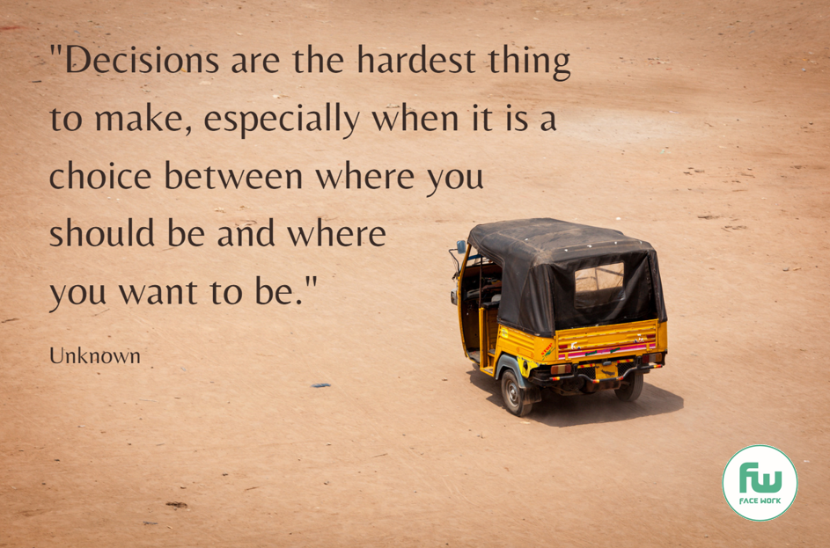
Finally, remember:
Making decisions can be very hard to make, especially when you are facing challenging personal circumstances.
But don’t give up.
Could you send this picture to a friend who you know is having to make a big decision?
(Right click on the image with your mouse, save and then send)
Remember too, that making bold decisions takes courage.
Don’t let anyone pour scorn on your courage. The easiest thing to do is to not make a decision.
Could you send this picture to a friend who you know is having to make a courageous decision?
Finally we all make mistakes. Yes these can be serious and difficult to get over, but they don’t define us.
Could you send this picture to a friend who you know is feeling a failure?
Now return to the rating card you scored yourself at the start – how would you rate yourself now ?

Slide 7
