Slide 1
CV’s and Covering Letters
Note: Plain cover master style
This text box is for guidance only – please delete
Hazel Dales, Principal Jobs and Skills Officer
Hazel.dales@lewisham.gov.uk

Slide 2
Introducing CV’s
What should be on the CV?
Principles to follow of a good CV
Types of CV (master CV, skills based, classic)
Top Tips: Applicant Tracking Systems
Personal profiles: selling yourself
Key skills
Introducing Covering Letters (what and why)
What should be included?
CV content vs. Covering Letter Content

Slide 3
Curriculum Vitae - CV
Latin for “the course of one’s life”
A short summary of a job seekers employment history, qualifications, education and some limited personal information
It is your first chance to promote yourself to an employer
A CV should hold enough relevant information, so that an employer can decide if they want to offer an interview
Most CV’s are read in less than 30 seconds

Slide 4
What should be on the CV?
Your name & contact information
Your key skills and achievements
Work history, including paid, voluntary and work experience
Education and training background
Relevant interests
Your photo
Your date of birth, race or nationality, family status etc.
Your full address
The full contact details of your references

Slide 5
Principle 1: Essential Information Only
Keep CV’s to 2 sides of A4
Only include essential information: employment history, work experience, education and training, key skills and personal profile
If you have a lot of work experience or training, include what is most relevant to the job you are applying for, or the most recent

Slide 6
Principle 2: Be Clear and Concise
Use short sentences. Avoid clichés and generic terms.
Give specific examples of results you have achieved, if possible quantify your achievements.
Make sure your CV is up to date. If you have gaps in your experience on your CV, explain them briefly. Highlight any new skills you have gained on a career gap.

Slide 7
Principle 3: Adapt your CV to the role
Each vacancy will be slightly different, adapt your CV. Highlight your strengths and transferable skills according to the application.
If you have the skills needed, put this clearly in the key skills section.
When you have finished writing, check you have matched your skills to the skills required on the job description.
Don’t lie and say you have done more than you have. You will get caught out!

Slide 8
Principle 4: Presentation
CV’s are visual documents, make them clear and easy to read
Have clear headings and use bullet points, make sure key information is easy to read
Adjust the style to the sector, a graphic design CV is different from an accountant
Do not heavily format your CV unless you have to, it may not get passed ‘Applicant Tracking Systems’

Slide 9
Your name
Email/ phone number
London, England
Personal profile
A short statement (100 words or less) summarising your skills and what you are looking for. You should change this section to match the job you are applying for.
Key Skills & Achievements
Approx. 5 key skills or career highlights
Avoid cliché statements such as ‘hardworker’
Ensure these reflect the job(s) you are applying for
Work History
Most recent first, a short summary of roles with bullet points of duties
Education and Training
Most recent first, you can omit dates if you feel this will impact impartiality
Interests
Leave out if you have no space, but nice to include interesting points, sports or music interests
References
‘available upon request’

Slide 10
Top CV Tips: Applicant Tracking Systems
Use standard, clear headings
Use key words and phrases that match the job adverts you apply for
Use a variety of key words and buzz words that mean the same thing
Save as a word document rather than pdf
Don’t use Headers and Footers
Don’t use columns or tables
Use a traditional, simple font such as Arial
Use the same font and font size throughout
Avoid large ‘white spaces’ between sections
Write in reverse chronological order
Keep it to two pages
Remember, many employers use ‘Applicant Tracking Systems’ to review CV’s, so follow these tips to optimise your CV for this software/

Slide 11
Selling yourself: Personal Profile
Your personal profile is a brief summary of you, as a professional.
You can summarise your experience, as well as your professional qualities and personal attributes.
You can include why you are applying, or why you would be a good fit for the role.
Keep it brief
Avoid generic terms, think about the qualities you have that make you special, and a good match for the company.

Slide 12
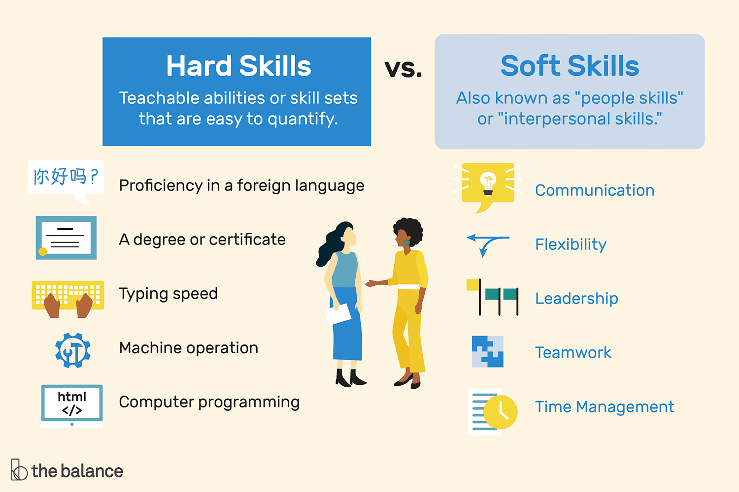
Selling yourself: Key Skills

Slide 13
Covering Letters
Applications with a covering letter are more likely to be invited to interview, than CV applications alone.
Research the company and examine the job description to make it as relevant as possible.
Avoid just repeating what is in your CV, this is an opportunity to highlight in more detail why you are a good match for the role.
If you are having a career change, this is a good chance to describe how your skills are relevant to the new sector.
Include specific, real life examples.
Do not make it longer than one side of A4 (1 page).

Slide 14
Cover Letter Structure
Layout as formal business letter, with the company address and hiring managers name, if known.
First paragraph - The opening statement should set out why you're writing the letter. Begin by stating the position you're applying for, where you saw it advertised and when you are available to start.
Second paragraph - Highlight relevant experience and demonstrate how your skills match the specific requirements of the job description. Summarise any additional strengths and explain how these could benefit the company.

Slide 15
Example
Dear Mr Smith,
I am writing to apply for the role of accountant with SG Construction, having seen the vacancy advertised on reed.com. Please find my CV enclosed.
As an ACCA qualified accountant with 15 years experience, I have the professional knowledge and expertise to excel in this role. I also have experience in change management, having led Wilder Coe through process transformation in 2020, to great success.

Slide 16
Cover Letter Structure
Third paragraph - Cover why you're suitable for the job, what attracted you to this type of work, why you're interested in working for the company and what you can offer the organisation. This is a good opportunity to show off your knowledge of the company, how your values match.
Last paragraph - Use the closing paragraph to round up your letter. Reiterate your interest in the role and indicate your desire for a personal interview. Now is the time to mention any unavailable dates.

Slide 17
Example
I have significant experience in the construction sector, and feel my values of integrity and professionalism match SG Construction. I have local knowledge of the projects you are currently involved in and feel I will be a great team fit.
Thank you for considering my application, I am immediately available for interview and look forward to the opportunity to interview.
Yours sincerely,
H Dales

Slide 18
Help is available: Lewisham Works
Unemployed and living in Lewisham?
We can help you find training, volunteering or a job
Interpreters are available
Staff that speak Polish & Russian
jobsandskills@lewisham.gov.uk

