Slide 1
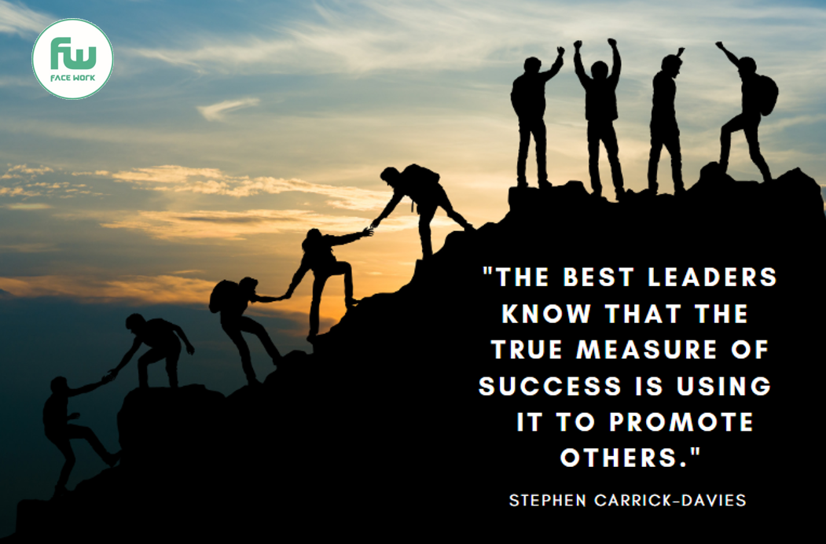
FACEWORK SKILLS CHALLENGE
PROMOTING OTHERS
It may seem strange to identify Promoting Others as a skill for the modern workplace. Surely we should be promoting ourselves! To the contrary, modern businesses thrive when every member of the work team is playing to their strengths. Increasingly modern companies are looking for staff who can work well in a team and promote other people within the team. They need staff who think WE not ME!
This skill is hard to acquire if you are someone who feels that you have not been given the opportunity others have. Why should you be promoting other people, when no-one is promoting you ? However if you are generous in your praise for others, work in a collaborative, non competitive manner and promote your colleagues there can be enormous rewards. Indeed true leadership in the workplace involves looking out for opportunities to support and promote others. Indeed if you want to be a good manager in the future you will need to develop this skill of promoting others.
ARE YOU UP FOR THE CHALLENGE TO IMPROVE ?

Slide 2
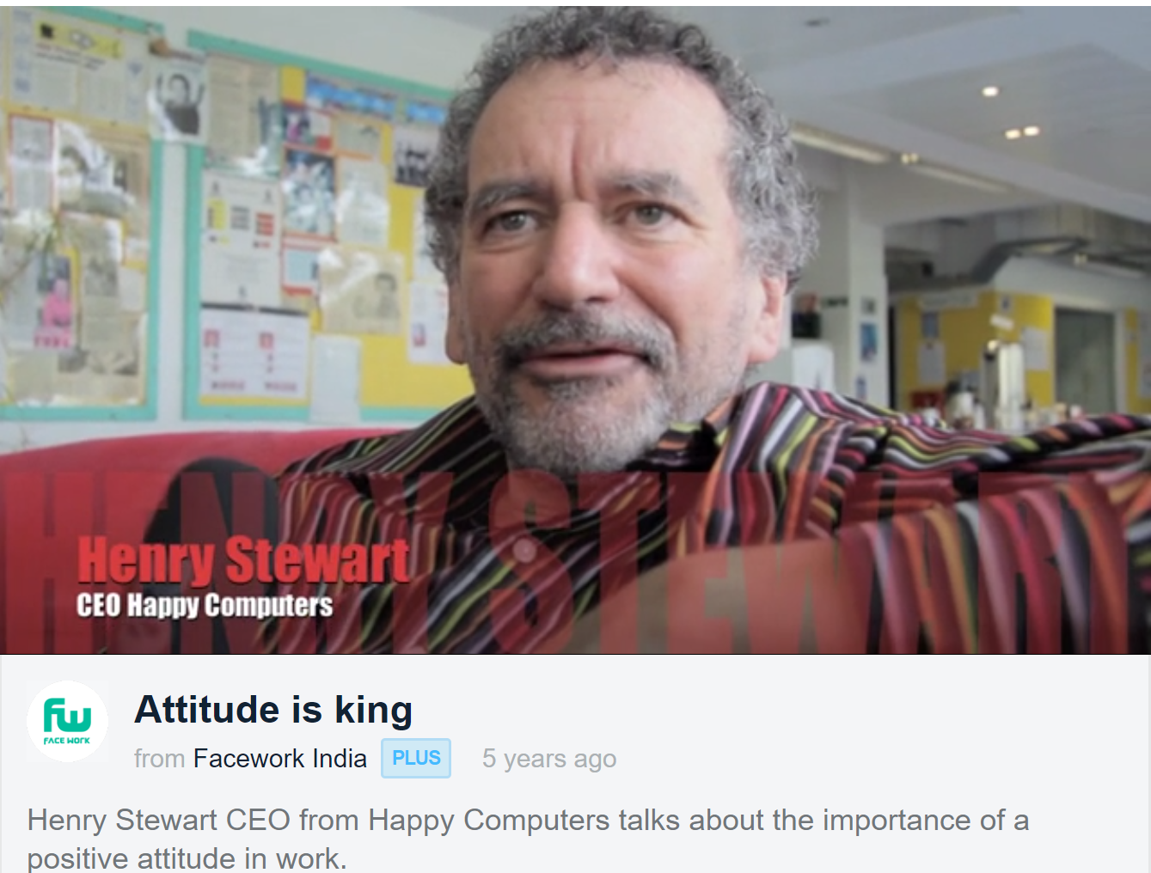
One way to understand why this skill is important is to talk to people who run businesses. Here is a short Facework interview from the boss of a leading UK computer training company Listen to what he says about what he is looking for when he is recruiting new staff. (57 seconds into the recording).
“So when we interview people [for a job] we never interview them on their own, we always bring them in as a group.
And the person we are looking for is the one that makes someone else look good, not makes themselves look good.”
https://vimeo.com/109248574
What do you think of this strategy ?
Why does this boss want staff who make other people look good?
If you were in a group interview what could you say or do which would show a prospective employer that you are someone who can work and indeed promote other people?
If you went for a job interview and didn’t get the job because the boss didn’t appreciate your actions or attitudes in promoting other people in the interview, do you think you would still want to work for a boss like this?
Of course there is a balance to take, it’s vital in an interview that you do show your strengths and promote your skills but if it is for a job in a team make sure you don’t come across as arrogant, or selfish.
Some companies are developing Job Descriptions for Teams as well as for individuals. What could you bring to a team ?

Slide 3
Be kind Show empathy – putting yourself in their shoes Find out something unique about them Recognise the benefits to you of helping someone else
Promoting other people is of course good for your personal life.
There are too many people who have inflated egos, un-realistic expectations of what they can do and don’t value other people.
Now imagine how you would feel if you avoided making this decision. Remember making no decision is a decision.

Slide 4
There are lots of articles and resources online which can help you master this skill. Here are 6 activities which can help you master the skill of making decisions.
TRY NOT TO WORRY THAT YOU WILL MAKE THE WRONG DECISION
You wont know whether you have made the wrong decision until you have made it. Who knows, you may have made the right decision. Worrying is the thief of progress. Yes be cautious, but don’t procrastinate and don’t let fear be your enemy. Remember if you don’t make a decision, that is a decision.
RECOGNISE WHAT YOUR DEFAULT POSITION IS.
As you develop your career you will begin to notice what your default position is. We all have one. Some people call it their “comfort zone”. Think about which way you usually decide things? Do you play safe, or take a risk, do you try to please other people, or say what you really want? Once you have recognised that your natural default, make sure you account for it when you make decisions, it’s not to say that it is wrong, but it may be unduly influencing you.
TALK TO GOOD DECISIONS MAKERS
Do you have a family friend, a previous teacher, or someone you have worked for in the past who you know is a good decision maker? Why not ask them;
What tips do you use to help you make decisions? Have you ever made a bad decision? What advice would give me as I try to get more confident in making decisions?
LEARN TO TRUST YOUR INSTINCT
As you grow in confidence and experience you can start to recognise when you have made a good decision. Think about what it was that helped you make that decision. Sometimes it is your own instinct or insight. Some people can ‘read’ other people well, can identify a trend or a new opportunity. Learn to trust your instinct but also remain humble and open to being wrong. That’s a powerful combination for being a good leader.
STUDY THE PROS AND CONS BEFORE YOU MAKE A DECISION
When trying to make a decision it’s helpful to list the things which are good and which are bad about the options. It’s also important to think about the ‘opportunity cost’ of making one decision over another. An opportunity cost is what you lose by making a decision in one way.
SHARE YOUR ADVICE ABOUT MAKING DECISIONS WITH OTHERS
When you become good at making decisions there are lots of people who will benefit from your insight, experience and skills. Indeed there are lots of jobs which require helping people make decisions. For example, counsellors, financial planners, career coaches and teachers. When you get good at making decisions, a whole world can open up to you and helping other people with decisions can give you enormous job satisfaction.

Slide 5
The Facework Challenge for this skill is to help someone make a decision.
Promoting team members
You have been asked by your teacher to produce a project about the environment with three team members.
Your teacher is looking to see how you work collaboratively and will be assessing your team work skills.
One of your group is reluctant to share their ideas. They privately share with you that they don’t feel confident.
How would you encourage this team member and promote the skills they have so that they do feel more confident to speak up and contribute their ideas and feel valued?
One way to help people find their voice is to validate their emotions by asking them pre-emptively about the root of their lack of confidence – ask if they feel:
Unheard
Ashamed of not knowing what to do
Intimidated by the potential reactions of others
Separated from the group
Can you think of any other feelings that could shake your confidence or someone else’s? How can show that we understand these thoughts and reassure those weighed down by them?

Slide 6
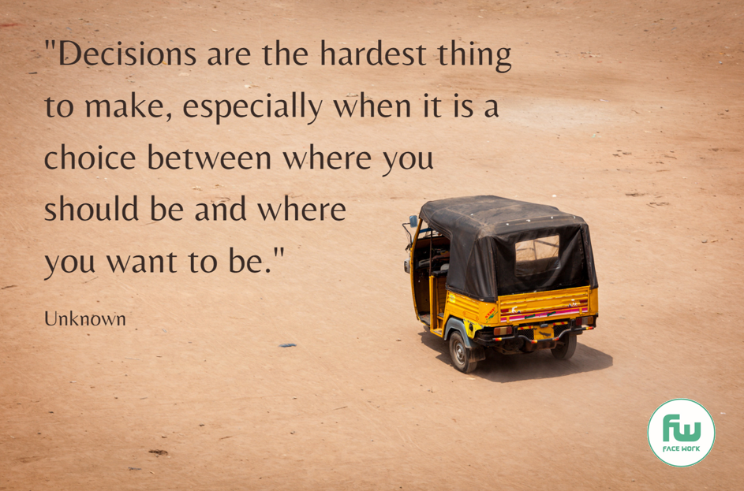
Finally, remember:
Making decisions can be very hard to make, especially when you are facing challenging personal circumstances.
But don’t give up.
Could you send this picture to a friend who you know is having to make a big decision?
(Right click on the image with your mouse, save and then send)
Remember too, that making bold decisions takes courage.
Don’t let anyone pour scorn on your courage. The easiest thing to do is to not make a decision.
Could you send this picture to a friend who you know is having to make a courageous decision?
Finally we all make mistakes. Yes these can be serious and difficult to get over, but they don’t define us.
Could you send this picture to a friend who you know is feeling a failure?
Now return to the rating card you scored yourself at the start – how would you rate yourself now ?

Slide 7
