Slide 1
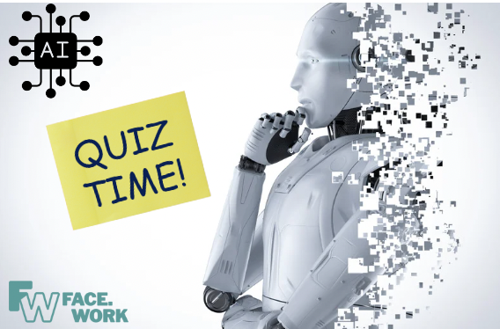
AI and the Future of Work

Slide 2
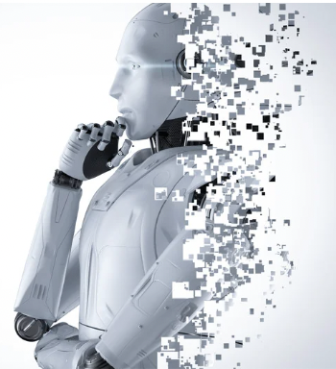
Quick Quiz on AI and employment
Question 1:
What is one way AI impacts the job market?
a) Decreases productivity
b) Increases unemployment
c) Enhances job opportunities
d) Reduces job satisfaction

Slide 3
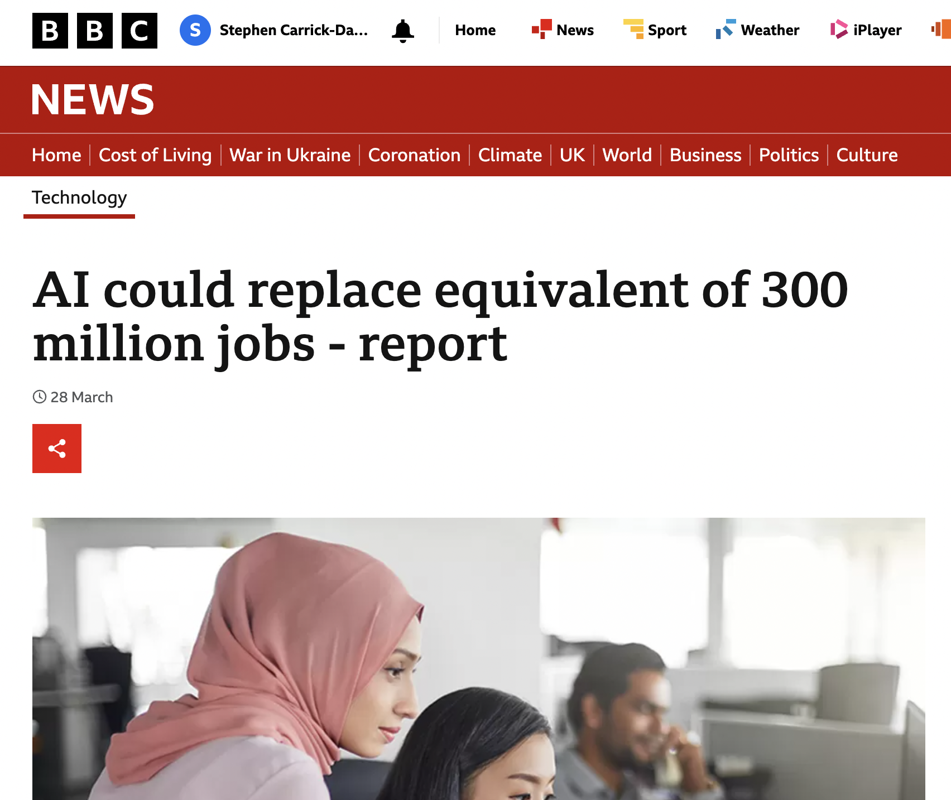
Question 1:
What is one way AI impacts the job market?
ANSWER
enhances job opportunities
but …..
https://www.bbc.co.uk/news/technology-65102150

Slide 4
Question 2:
What is one potential benefit of AI in the job market?
a) Increased creativity in job roles
b) Limited job growth
c) Decreased efficiency in workplace tasks
d) Decreased job security

Slide 5
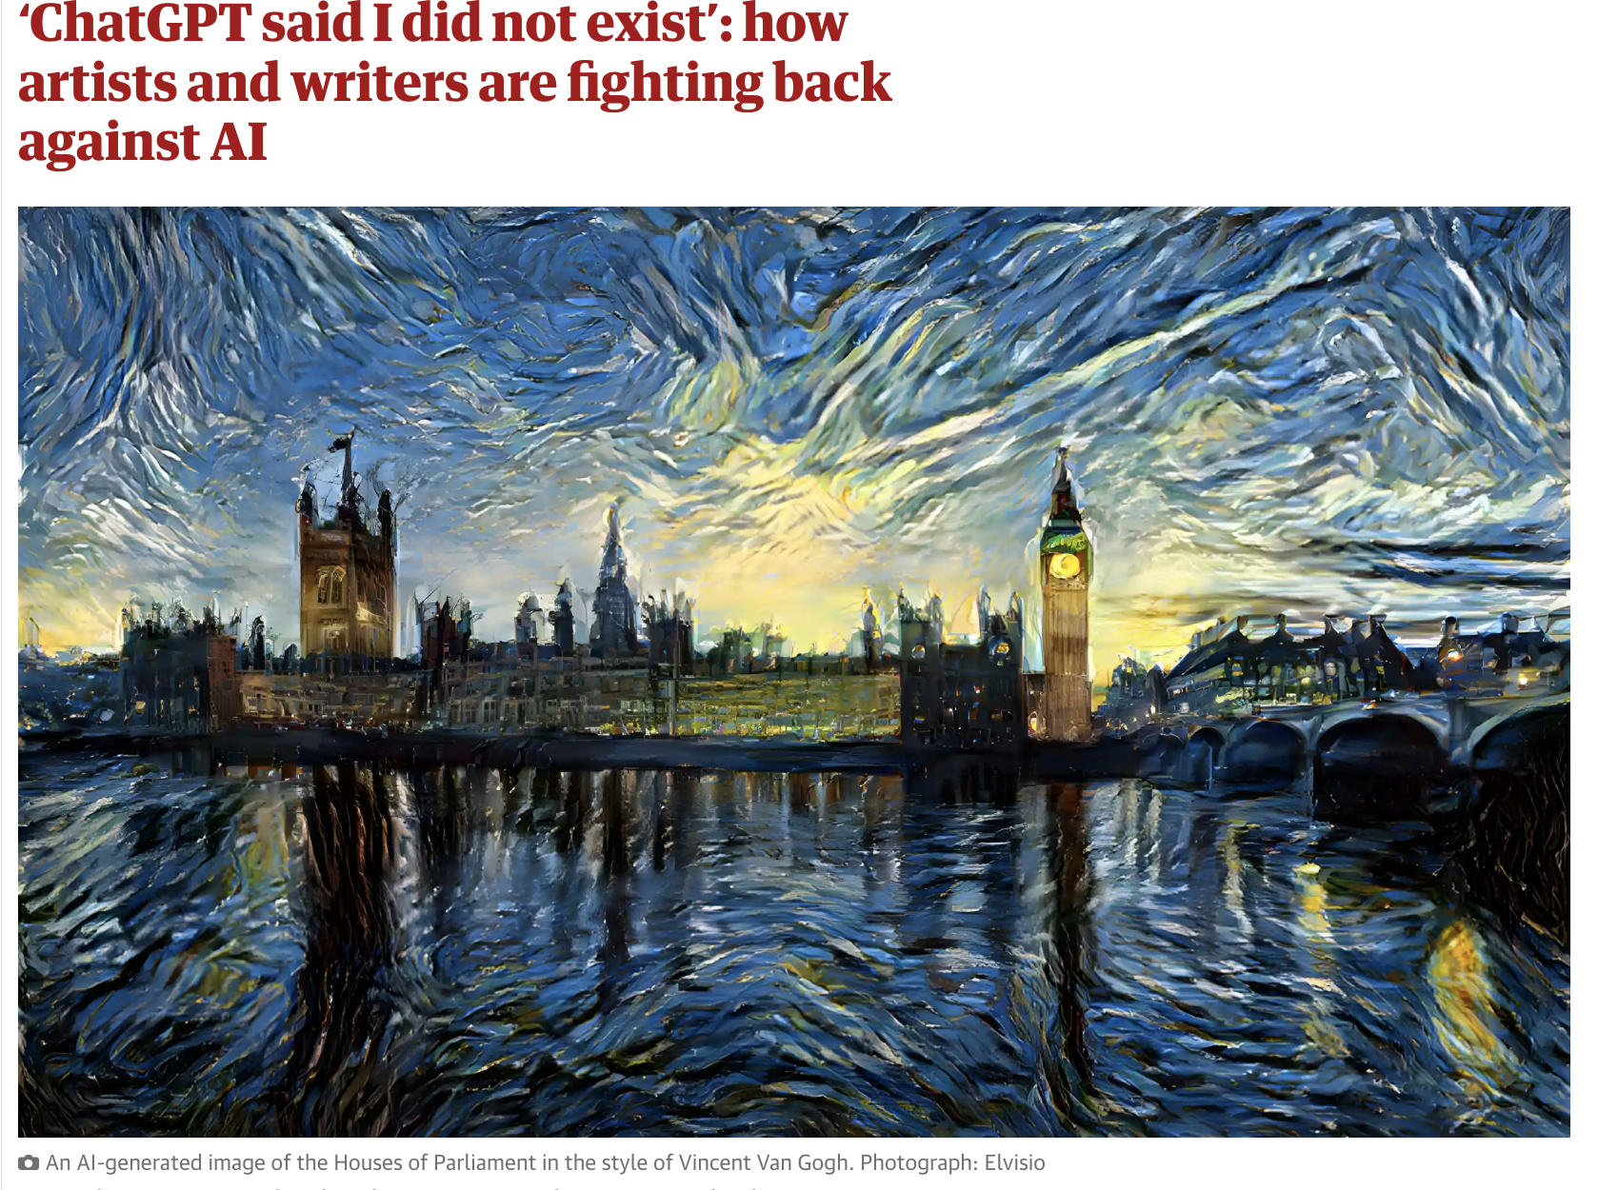
Question 2:
What is one potential benefit of AI in the job market?
ANSWER
a) Increased creativity in job roles
but…
https://www.theguardian.com/technology/2023/mar/18/chatgpt-said-i-did-not-exist-how-artists-and-writers-are-fighting-back-against-ai

Slide 6
Question 3:
How can AI impact job roles?
a) Replacing humans in repetitive tasks
b) Decreasing the demand for skilled workers
c) Increasing job security
d) Limiting the need for upskilling

Slide 7
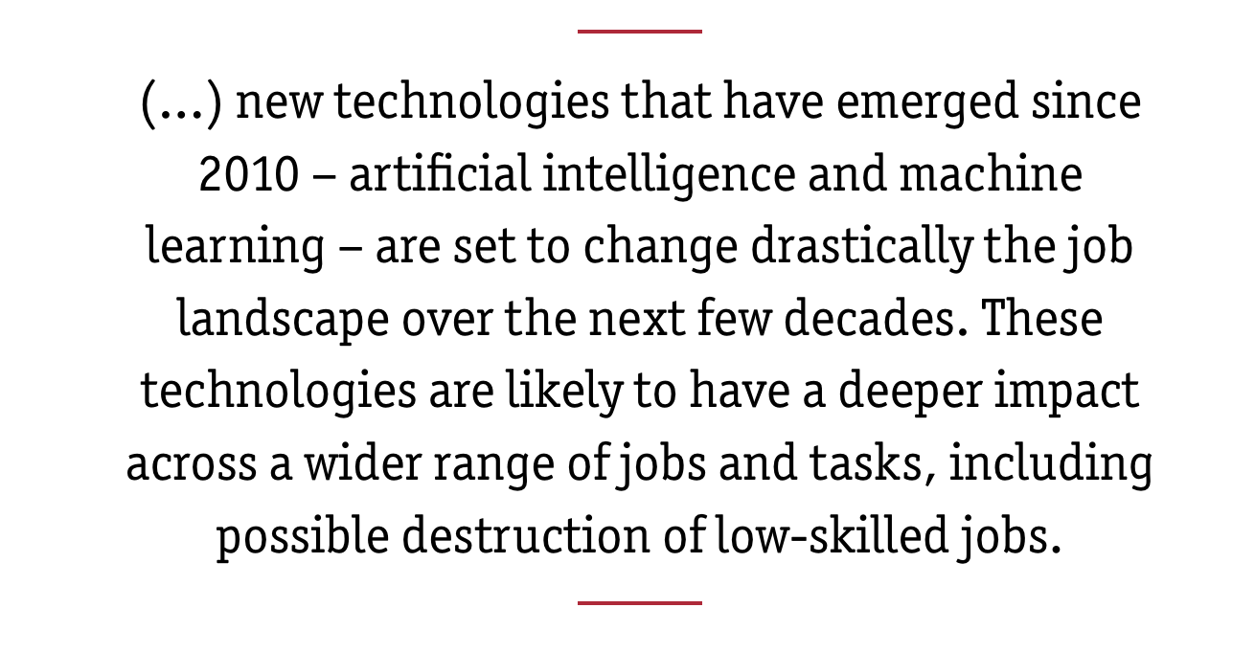
Question 3:
How can AI impact job roles?
ANSWER
a) Replacing humans in repetitive tasks
BUT….
https://www.bruegel.org/blog-post/artificial-intelligences-great-impact-low-and-middle-skilled-jobs

Slide 8
Quick Quiz on AI and employment
BUT
Question 4:
What is one ethical concern related to AI in the job market?
a) Increased workplace diversity
b) Bias in AI algorithms
c) Enhanced job opportunities for all
d) Minimized job displacement

Slide 9
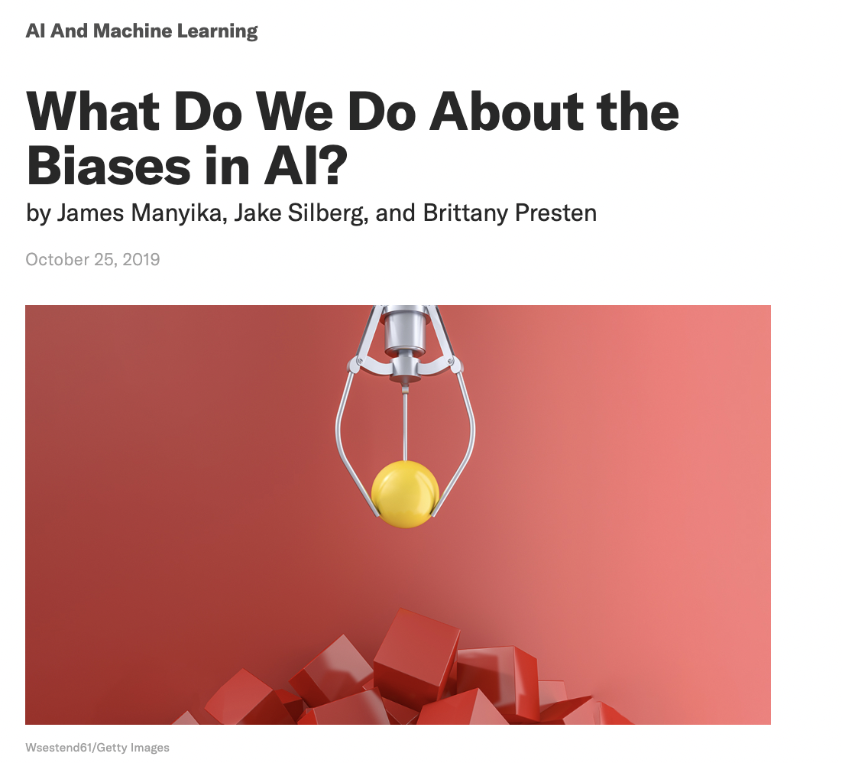
Question 4:
What is one ethical concern related to AI in the job market?
ANSWER
b) Bias in AI algorithms
https://hbr.org/2019/10/what-do-we-do-about-the-biases-in-ai

Slide 10
Question 5:
How can individuals adapt to AI's impact on the job market?
a) Avoiding technology in the workplace
b) Ignoring the potential benefits of AI
c) Embracing lifelong learning and upskilling
d) Resisting any changes brought by AI

Slide 11
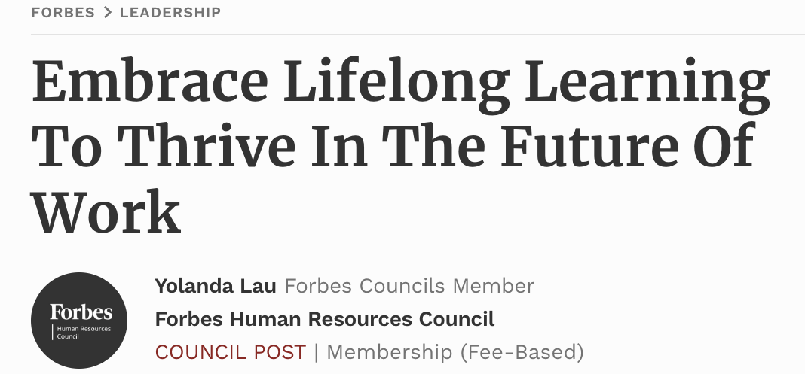
Answers
Question 5:
How can individuals adapt to AI's impact on the job market?
c) Embracing lifelong learning and upskilling
In the future of work, the critical skills for success are increasingly soft skills like emotional intelligence, adaptability and resilience. Success in the future of work requires becoming a lifelong learner. The world is changing faster than ever, and only through lifelong learning will we have the capability to adapt along with it.
https://www.forbes.com/sites/forbeshumanresourcescouncil/2021/09/30/embrace-lifelong-learning-to-thrive-in-the-future-of-work/?sh=3d86818a7631

Slide 12
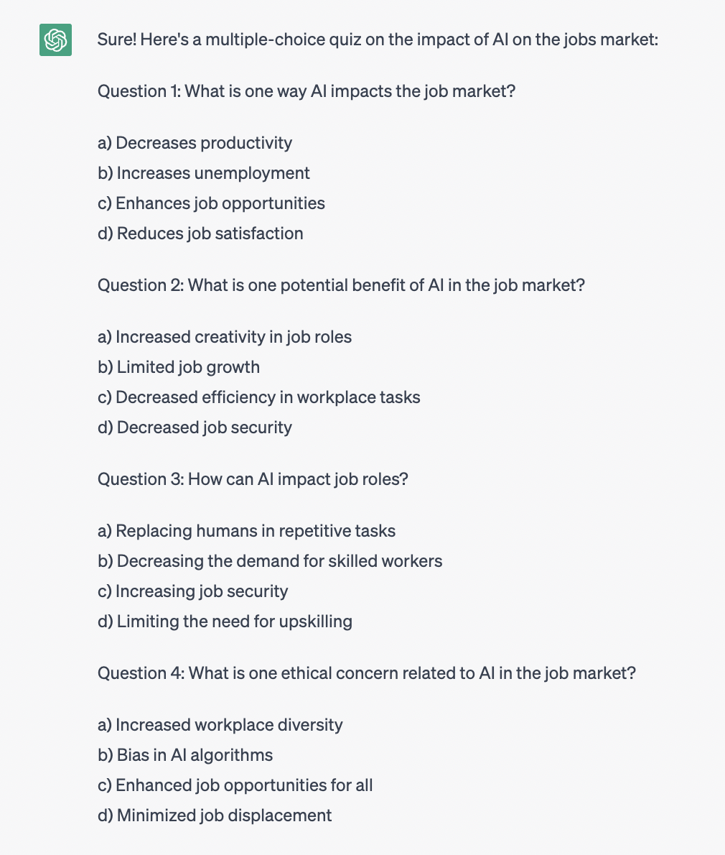
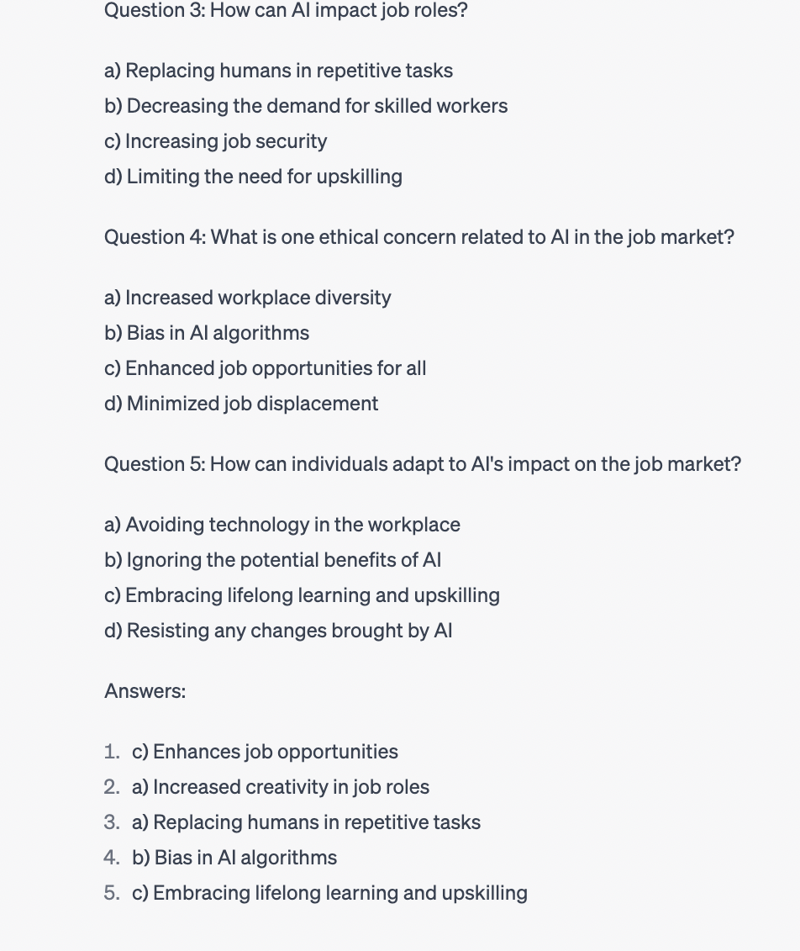
This quiz was generated by Chat GPT
https://chat.openai.com/c/be7ecd4c-cd37-40e8-84bd-df19cfcc05ad

Slide 13
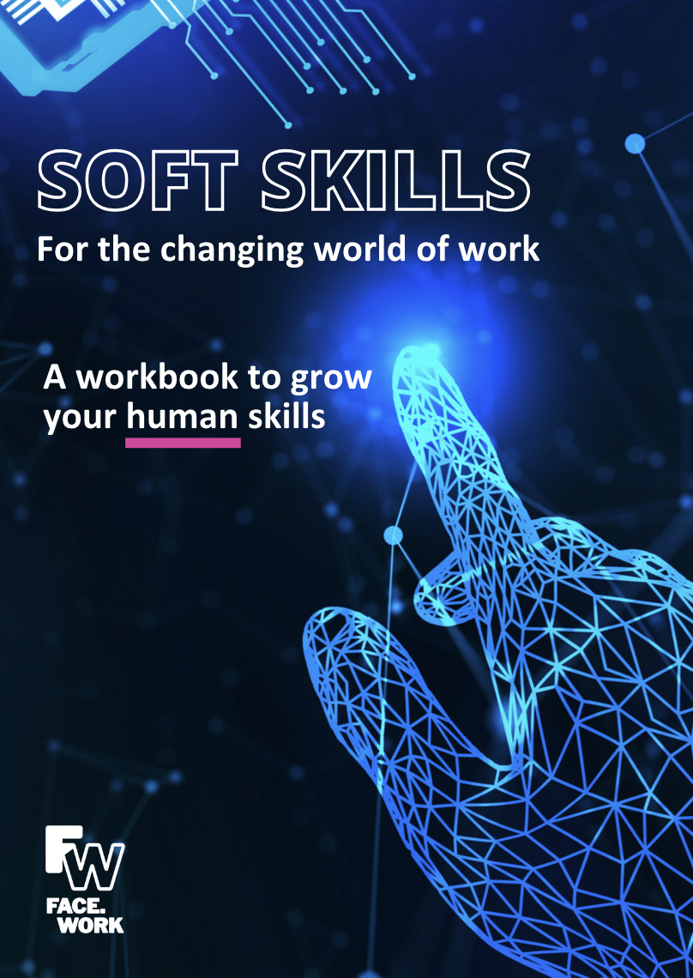
See www.face.work/resources for more unique soft-skills workbook

