Slide 1
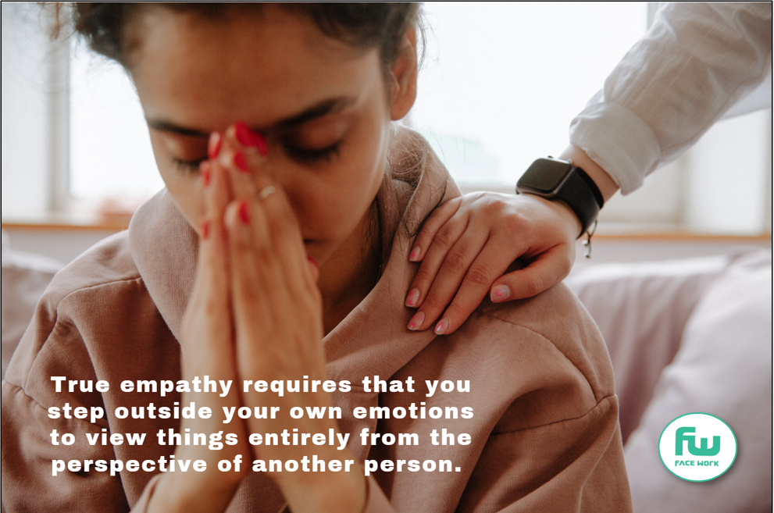
FACEWORK SKILLS CHALLENGE
SHOWING EMPATHY
Many people can be sympathetic to another person, but acting empathically involves feeling what another person is going through and relating to that person in a non-judgemental, compassionate way. If you have the capacity to recognise emotions in others, feel what they are experiencing and can place yourself in their shoes, then you have the skill of empathy.
In this Facework challenge we show you why this skill is so important in the workplace; especially when there is conflict or division. We will also give you practical advice on how you can develop this skill, both in your personal life and in the wider community. Finally there is a challenge at the end which will involve you putting the theory into practice
ARE YOU UP FOR THE CHALLENGE TO IMPROVE ?

Slide 2
Recognising and understanding other peoples’ emotions is a key skill in the workplace. Good employers know that if they are empathetic they can help resolve conflicts, build good teams and have a staff team who can improve relationships with clients and customers. However, sadly some managers are not very empathetic and can be self-conscious about discussing their own feelings, never mind anyone else’s. However, that doesn’t stop you trying to become a more empathetic employee – who knows, if you become good at this, you may help to change the whole culture of a workplace.
So how do we start to improve our skill in this area?
There are some jobs where you need to very empathetic. For example you can’t be a good teacher, counsellor or doctor if you aren’t empathetic. But empathy is a crucial skill in all workplaces and is a vital skill if you are part of a team. Good teams are those where empathy and care is in abundance, and good teams make successful companies.
Surveys such as Businessolver’s Workplace Empathy Monitor show that empathy has a direct impact on employee productivity, loyalty, and engagement. For example 77% of workers would be willing to work more hours for a more empathetic workplace while 92% of HR professionals note that a compassionate workplace is a major factor for employee retention.
Becoming more empathetic starts with noticing more.
To get better at empathising you have to switch from simply giving your opinion, to observing and listening better, as well as getting good at asking questions.
Doing this helps you see things from the other person's perspective and you begin to notice and recognize
behaviour patterns and causes.
You have two eyes, and two ears, but only one mouth.
This is so because you are supposed to look and listen more than you talk.
Lucca Kaldahl

Slide 3
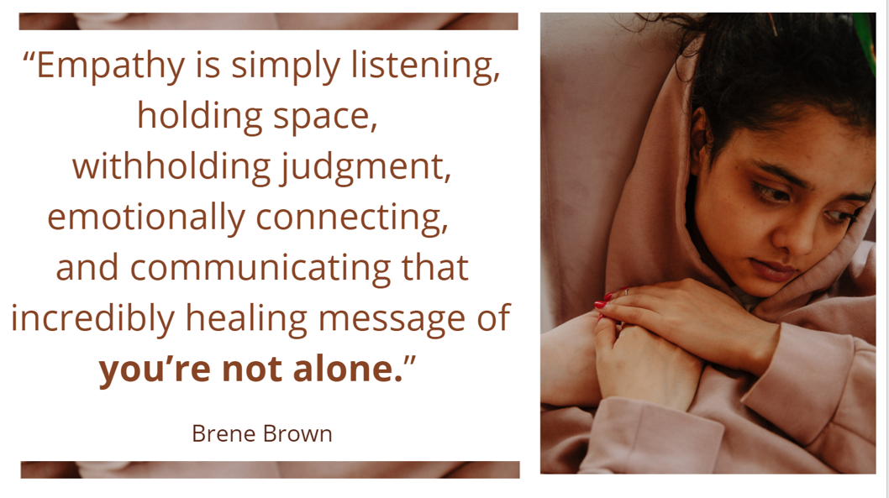
If you can get good at showing empathy in a work place,
you can apply this skill to lots of areas in your life. However, becoming a more empathetic person takes time and practice and you have to actively choose to act more empathetically.
Think of a situation where a friend showed you empathy.
How did it make you feel ?
What action was it that they did which gave you this feeling?
What did you learn from sharing and receiving ?
How you can become more empathetic.
Neuroscientists tell us that part of our brain perceives the feelings of others and the cognitive centre tries to understand why they feel that way and how we can be helpful to them. Connection and compassion are therefore crucial to developing empathy. Some people are naturally more empathetic than others, however anyone can increase their empathy skills. You can do this through:
Talking to New People: Being curious is a gift. If you can’t imagine what it is like to be another person. Try to get beyond the small talk and ask them what their daily life is like. If you are shy, consider following people on social media with different backgrounds than you have.
Trying Out Someone Else’s Life: Don’t just stand in someone else’s shoes, as the saying goes, but take a walk in them. If someone’s behaviour is annoying you, think about why. Consider what it’s like to live their daily life – what is their bus ride like, how much homework do they have and how much sleep do they get?
Starting to volunteer: Working on a project with other people reinforces everyone’s individual expertise and helps break down the differences that can divide people. There are lots of ways in which you can volunteer and give to others. For example, if you have experienced grief or loss, join with others who have experienced something similar. You will soon see empathy in action!
Finally, Interview an empathetic
person: It’s simple but this can
be one of the most positive and
enlightening steps.
How could you show empathy to a friend or family member who is struggling?

Slide 4
There are lots of articles and resources online which can help you master this skill. Here are five things which you can start to do now.
Make an active choice to listen better.
Good listeners pay close attention to what is being said. They don’t interrupt and support someone in telling their story.
2) Master the art of asking good open, questions.
Asking good, open questions not only show that you are listening, questions can help clarify to the person talking the issues they are sharing and make them feel understood, respected, and valued.
3) Summarize your understanding.
Once the speaker has finished talking, summarize your understanding of the situation they have shared back to them: “Have I understood this correctly?”
4) Show that you are vulnerable.
Being vulnerable as we are giving help communicates that we are all human; complete with our own weaknesses, mistakes and fears. Sharing your experience helps the other person open up and creates a feeling of “sameness” that gives the other person something to connect to.
5) Finally, Follow-up.
Reassure the person that you will keep what has been shared confidential but actively follow up and be there for your friend.
How would you rate your skills at showing Empathy now that you have learnt some ways to improve your skill?

Slide 6
